Slide 1
PHP Form Validation
Course Code: CSC 3215
Course Title: WEB TECHNOLOGIES
Dept. of Computer Science
Faculty of Science and Technology
Lab No: | 3 | Week No: | 3 | Semester:
Lecturer: | Supta Richard Philip & richard@aiub.edu

Slide 2
Lecture Outline
Learning Objectives
PHP Form Handling
HTTP POST
HTTP GET
HTTP GET vs HTTP POST
PHP Form Validation
Books and References

Slide 3
Learning Objectives
In this Lab, we will learn more details about HTML form elements i.e. different type of form, designing different type of HTML form and form action.
We will also learn HTTP GET and POST.
Handling form data using $_GET or $_POST methods and validations form data using PHP.

Slide 4
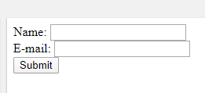
PHP Form Handling
The PHP superglobals $_GET and $_POST are used to collect form-data.
The example displays a simple HTML form with two input fields and a submit button:
<html> <body> <form action="welcome.php" method="post"> Name: <input type="text" name="name"><br> E-mail: <input type="text" name="email"><br> <input type="submit"> </form> </body> </html>

Slide 5
PHP Form Handling
HTTP POST
When the user fills out the form and clicks the submit button, the form data is sent for processing to a PHP file named "welcome.php". The form data is sent with the HTTP POST method.
welcome.php file
<html> <body> Welcome <?php echo $_POST["name"]; ?><br> Your email address is: <?php echo $_POST["email"]; ?> </body> </html>

Slide 6
PHP Form Handling
HTTP GET
The same result could also be achieved using the HTTP GET method:
Welcome_get.php file
<html> <body> Welcome <?php echo $_GET["name"]; ?><br> Your email address is: <?php echo $_GET["email"]; ?> </body> </html>

Slide 7
PHP Form Handling
HTTP GET vs HTTP POST
Both GET and POST create an array (e.g. array( key1 => value1, key2 => value2, key3 => value3, ...)). This array holds key/value pairs, where keys are the names of the form controls and values are the input data from the user.
$_GET is an array of variables passed to the current script via the URL parameters.
Information sent from a form with the GET method is visible to everyone (all variable names and values are displayed in the URL).
$_POST is an array of variables passed to the current script via the HTTP POST method.
Information sent from a form with the POST method is invisible to others

Slide 8
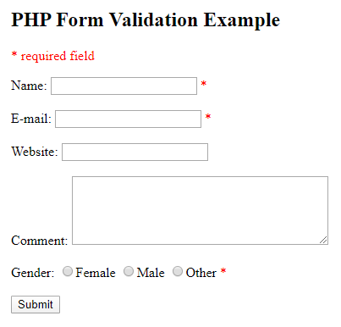
PHP Form Validation
Proper validation of form data is important to protect your form from hackers and spammers!
Lets consider the example.

Slide 9
PHP Form Validation
Field | Validation Rules
Name | Required. + Must only contain letters and whitespace
E-mail | Required. + Must contain a valid email address (with @ and .)
Website | Optional. If present, it must contain a valid URL
Comment | Optional. Multi-line input field (textarea)
Gender | Required. Must select one

Slide 10
PHP Functions
The empty() function checks whether a variable is empty or not. This function returns false if the variable exists and is not empty, otherwise it returns true.
The following values evaluates to empty:
0
0.0
"0"
""
NULL
FALSE
array()

Slide 11
PHP Functions
<?php $a = 0; // True because $a is empty if (empty($a)) { echo "Variable 'a' is empty.<br>"; } ?>
https://www.w3schools.com/php/func_var_empty.asp

Slide 12
PHP Functions
The isset() function checks whether a variable is set, which means that it has to be declared and is not NULL.
This function returns true if the variable exists and is not NULL, otherwise it returns false.

Slide 13
PHP Functions
<?php $a = 0; // True because $a is set if (isset($a)) { echo "Variable 'a' is set.<br>"; } $b = null; // False because $b is NULL if (isset($b)) { echo "Variable 'b' is set."; } ?>
https://www.w3schools.com/php/func_var_isset.asp

Slide 14
PHP Functions
The preg_match() function returns whether a match was found in a string.
<?php $str = "Visit W3Schools"; $pattern = "/w3schools/i"; echo preg_match($pattern, $str); ?>
https://www.w3schools.com/php/func_regex_preg_match.asp

Slide 15
Books
W3Schools Online Web Tutorials; URL: http://www.w3schools.com
PHP Documentation; URL: http://www.php.net/docs.php
Sams Teach Yourself Ajax JavaScript and PHP All in One; Phil Ballard and Michael Moncur; Sams Publishing; 2010
JavaScript Phrasebook; Christian Wenz; Sams Publishing; 2007
PHP and MySQL Web Development, 4/E; Luke Welling and Laura Thomson; Addison-Wesley Professional; 2009
JavaScript for Programmers Paul J. Deitel and Harvey M. Deitel; Prentice Hall; 2009
Beginning PHP5, Apache, and MySQL Web Development; Elizabeth Naramore, Jason Gerner, Yann Le Scouarnec, Jeremy Stolz and Michael K. Glass; Wiley Publishing; 2005
XML in a Nutshell, 3/E; Elliotte Rusty Harold and W. Scott Means; O'Reilly Media; 2004

Slide 16
References
https://www.w3schools.com/php/php_forms.asp

